Slide 1
Final Engagement
Attack, Defense & Analysis of a Vulnerable Network

Slide 2
Table of Contents
This document contains the following resources:
Network Topology & Critical Vulnerabilities
Traffic Profile
Normal Activity
Malicious Activity

Slide 3
Network Topology
& Critical Vulnerabilities
‹#›

Slide 4
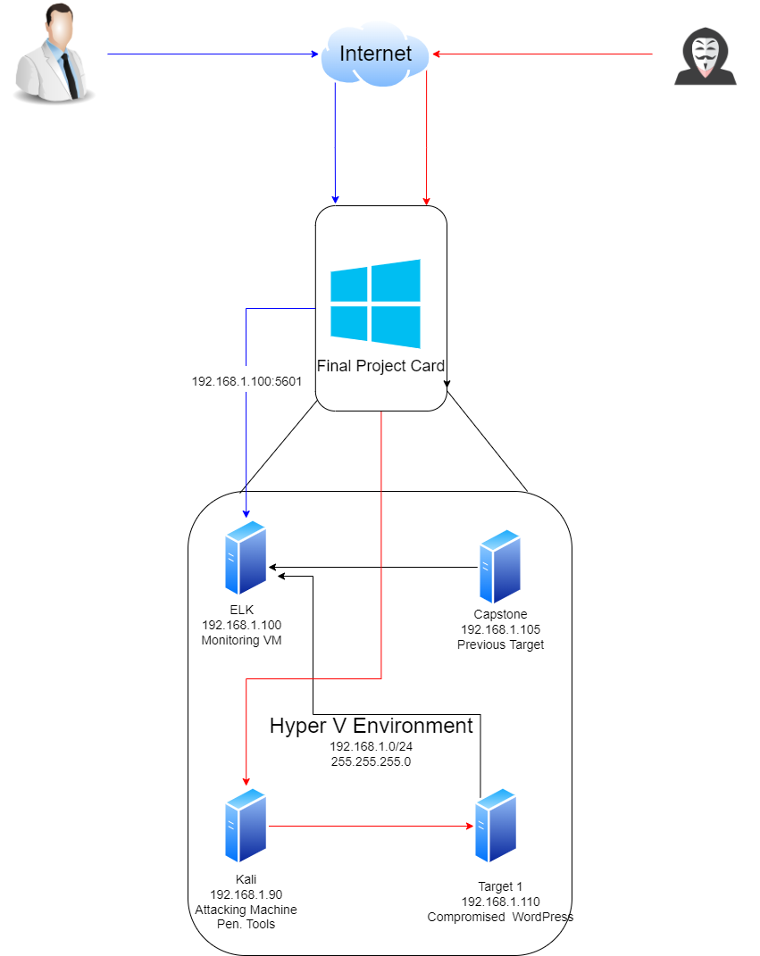
Network Topology
Penetration Tester
Network
Address Range:192.168.1.0/24
Netmask:255.255.255.0
Gateway:10.0.0.1
Machines
IPv4:192.168.1.100
OS:Linux
Hostname:Kibana
IPv4:192.168.1.90
OS:Linux
Hostname:Kali
IPv4:192.168.1.110
OS:Linux
Hostname:Target 1
IPv4:192.168.1.105
OS:Linux
Hostname:Capstone
SOC Analyst

Slide 5
Critical Vulnerabilities: Target 1
Our assessment uncovered the following critical vulnerabilities in Target 1.
Vulnerability | Description | Impact
Open Access to ports | port 22 and port 80 both open and easy to access | Vulnerable to Brute force attacks
Enumerating usernames in Wordpress | Easy to find usernames to use to exploit | Able to find usernames makes easy access for attackers
Simple Passwords | Passwords are not following good password qualities | Easiest way to get in by brute forcing or being guessed
Root vulnerability with Python | Vulnerable to a local user attack using a Python script | Can gain full administrative access

Slide 6
Traffic Profile
‹#›

Slide 7
Traffic Profile
Our analysis identified the following characteristics of the traffic on the network:
Feature | Value | Description
Top Talkers (IP Addresses) | 172.16.4.205 (51364 packets) 185.243.115.84 (30344 packets) 10.0.0.201 (19503 packets) | Machines that sent the most traffic.
Most Common Protocols | Transmission Control Protocol (TCP) (92280 packets) User Datagram Protocol (UDP) (11697 packets) | Three most common protocols on the network.
# of Unique IP Addresses | 808 unique addresses | Count of observed IP addresses.
Subnets | 10.11.11.0/24, 10.6.12.0/24, 172.217.9.0/24, 172.217.12.0/24, 204.3.251.0/24, 205.251.12.0/24 | Observed subnet ranges.
# of Malware Species | 2 (spyware, command and control) | Number of malware binaries identified in traffic.
Notes:
You may have more than 2 subnets.

Slide 8
Behavioral Analysis
Purpose of Traffic on the Network
Users were observed engaging in the following kinds of activity.
“Normal” Activity
Normal activity included activities like shopping, reading news articles and light browsing on instagram
Suspicious Activity
We found a number of suspicious activities on the Network, Signs of malware and malicious downloads causing the network to become vulnerable. Also it was found that a youtube channel was being hosted on the network

Slide 9
Normal Activity
‹#›

Slide 10
Normal Behavior - Wireshark
What kind of traffic did you observe? Which protocol(s)?
TLSv1.2-3 (Transport Layer Security)
Which is the newest SSL protocol that implements the SHA-256 hash to better protect the integrity of the data.
DNS (Domain Name System)
LDAP (Lightweight Directory Access Protocol)
What, specifically, was the user doing? Which site were they browsing? Etc.
The LDAP traffic shows persons in the network moving about throughout the file system and other resources. We can see some websites accessed like bing.com and skype with DNS. The TLS just shows encrypted data being moved between different parts of the network. Here are some snippets of the packets themselves.

Slide 11
Normal Behavior Continued…
Summarize the following:
What kind of traffic did you observe? Which protocol(s)?
HTTP (Hypertext Transfer Protocol)
UDP (User Datagram Protocol)
Connectionless, meaning it will send the information even if the whole thing isn’t being received.
TCP (Transmission Control Protocol)
Uses the 3 Way Handshake to establish connections beforehand.
What, specifically, was the user doing? Which site were they browsing? Etc.
Looking at HTTP we found some users downloading simple files and photos like the Beauty.jpg. We see talk with UDP moving between ports 63448 to 55177. As well as a good amount of TCP communication with the 3 way handshake from port 80 (as seen below).

Slide 12
Malicious Activity
‹#›

Slide 13
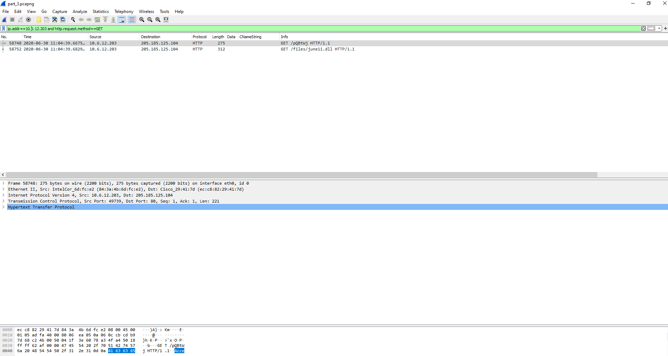
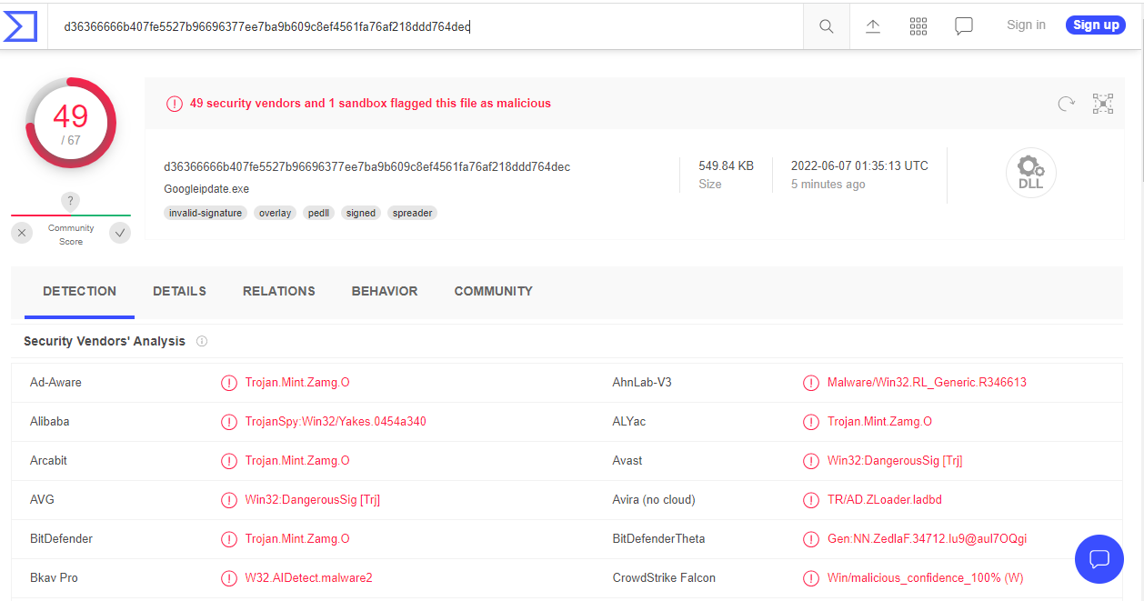
Trojan Horse (Zloader)
Summarize the following: Frank-n-ted.com(10.6.12.20) file was downloaded that was malicious
User was trying to download a file when file was downloaded
it was malware and corrupted users machine
frank-n-ted.com (10.6.12.203) downloaded a file
malicious file from 205.185.125.104
Saw that malicious file June11.dll was downloaded to
Machine 10.6.12.203
When we export the file with wireshark and
Identify it we see it is classified as a trojan

Slide 14
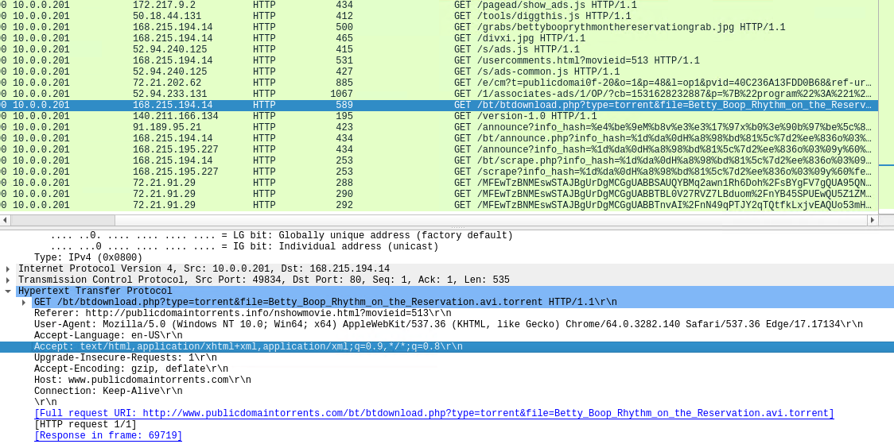
Illegal Torrent Download
Summarize the following:
We noticed a user visiting many suspicious websites and downloading .jpg and .gif files
The user visited a site http://public domianstorrents.info/grabs/bettybooprythmonthereservationgrab.jpg to download a photo, this ended up being a torrent file

Slide 15
The End
‹#›

